Slide 1

Project Kick-off Presentation
Presented By: ProThoughts
Date:

Slide 2

Agenda
Use links to go to a different page inside your presentation.
Highlight the text you want to hyperlink, click the link symbol that appears above that text, then select from the dropdown the page that you want to connect.
Project Background | 03
Team Members | 04
Project Scope and Deliverables | 05
Project Timeline | 06
Project Budget | 07
Project Risks | 08
Management Tools and Methods | 09
Monitoring | 10

Slide 3
Project Background
Drag and drop your photo or video! Click the sample photo or video and delete. Select yours from the uploads tab, drag, and then drop inside the frame!
Briefly elaborate on the history and context
of the project. Share the objectives that it is aiming to achieve too.

Slide 4

Team Members
Introduce the people who will work on the project.
Carla Ferrer
Project Manager
Ashley Intal
Team member 1
Mark Santos
Team member 2
Ellen Diaz
Team member 3
Trisha Lopez
Team member 4

Slide 5



Project Scope and Deliverables
Describe what the project will entail and its anticipated output.
PROJECT PHASE
SCOPE
DELIVERABLES
Phase 1 | Write a project activity or task | Write the corresponding deliverable that will come from the activity or task
Customize this table! Just right-click on any cell to see all the available table functions.
To merge, highlight first two or more cells, then click "Merge Cells" to organize your table according to your needs!

Slide 6
Project Timeline
Use the chart to schedule all the project tasks that need to be accomplished.
Tasks | Month 1 | Month 2 | Month 3 | Month 4 | Month 5
Project Task 1
Project Task 2
Project Task 3
Project Task 4
Project Task 5
Project Task 6
Project Task 7
Customize this table! Just right-click on any cell to see all the available table functions.
To merge, highlight first two or more cells, then click "Merge Cells" to organize your table according to your needs!

Slide 7
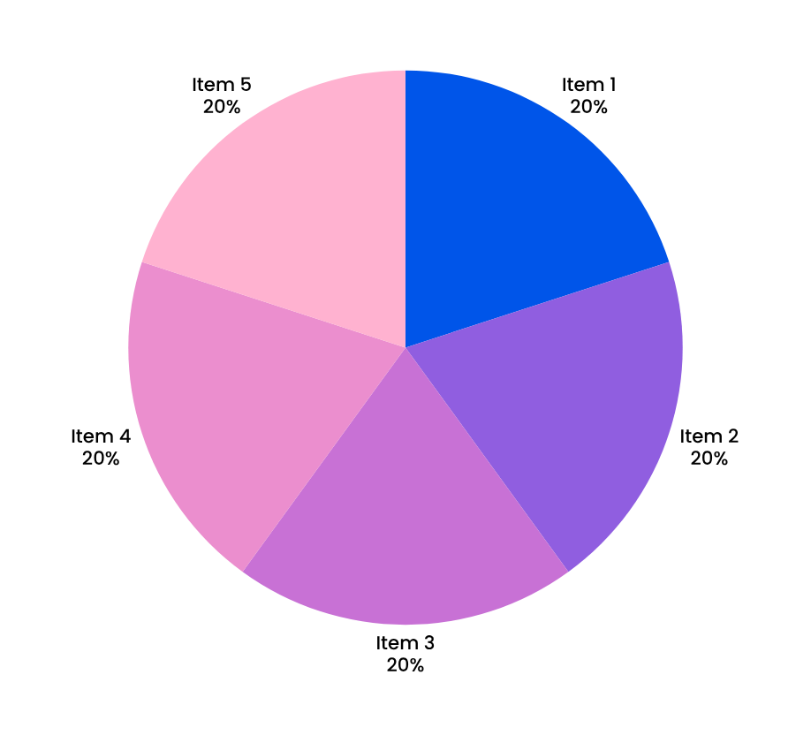

Project Budget
Use the graph to present the estimated budget allocation for each project item.
Item 1:
Briefly elaborate on this cost/expense.
Item 2:
Briefly elaborate on this cost/expense.
Item 3:
Briefly elaborate on this cost/expense.

Slide 8

1
List a potential risk.
Share how the risk might be mitigated.
Project Risks
Identify and rank the potential obstacles
that may hinder the project.
2
List a potential risk.
Share how the risk might be mitigated.
3
List a potential risk.
Share how the risk might be mitigated.
4
List a potential risk.
Share how the risk might be mitigated.

Slide 9
Management Tools and Methods
List down the tools and methods for the project and explain how they work.
Management Tools
Management Methods
Add the first tool.
Add the second tool.
Add the third tool.
Add the first method.
Add the second method.
Add the third method.

Slide 10





Project Monitoring
Once the project begins to move forward, log the development of each phase.
Project Phase 1
Project Phase 2
Project Phase 3
Provide a quick status update.
Provide a quick status update.
Provide a quick status update.

Slide 11
Thank you!

